Slide 1
Data Science in Resolving Obsessive and Compulsive Disorder FACULTY HARIPRAKAASH N DHIVYA P JEEVANANTHAM M SETHUHARISH K PRANAV ANAND V

Slide 2
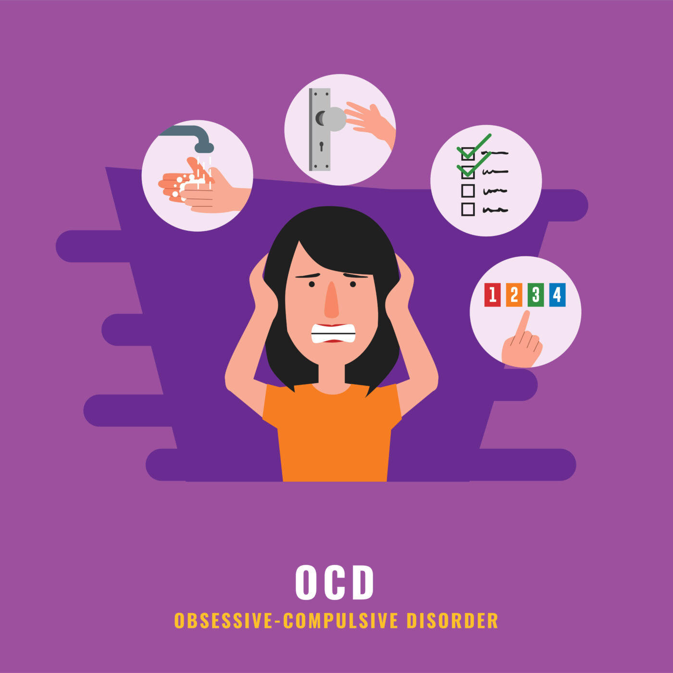
PROBLEM STATEMENT:
Now a days many people are being affected from OCD.
Mental illness also affects physical health as well as financial health.
Many people are unaware about how to get rid of the problem.
Many people hesitate to speak out their problem to their family members and friends .
Also day by day the suicidal death rates also increasing due to this mental illness problems.

Slide 3
EXISTING SOLUTIONS:
Till now the people with OCD can consult the psychiatrist doctors and get the solution for their problems.
There are some chat bot apps related to mental illness but they are less effective and they are only depression and not for ocd.

Slide 4
PROPOSED SOLUTIONS:
A psychiatrist chat bot can be created and can be made to give solutions to the mental illness problems such as OCD as much as possible.
By using data science and machine learning algorithms we can predict that in future whether the person will get affected or not from OCD.
Not only giving solutions, chat bot can be made to give some useful tips and advices on overcoming the problem without medications.
Some people might not even share their problems with doctor . In that situation the chat bot will be useful.

Slide 5
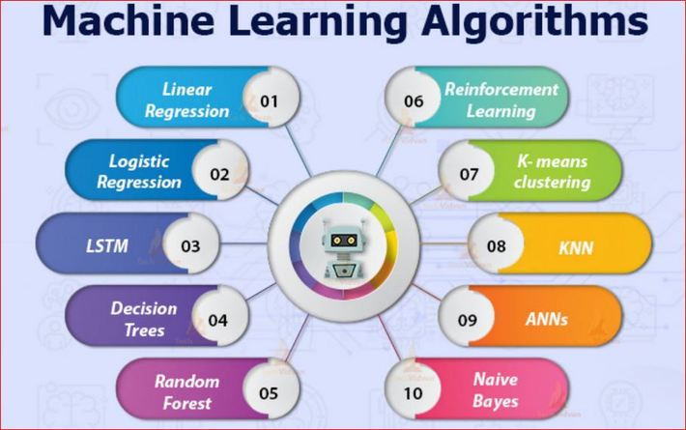
FUNCTIONALITY:
Apriori Algorithm
K means clustering
Naïve Bayes algorithm
Decision tree
NLP
Random Forest

Slide 6
START
USER INPUT
conversation
CONVER SATION/ QUERY
Query
IF IT IS IN THE MODULE
yes
REPLY WITH SIMPLE SENTENCES
MATCHING WITH WORDS IN THE TRAINED MODULE
DISPLAY RESULT
STOP

Slide 7
RESULTS:
By implementing, this people will get benefitted at lower cost.
In future almost 60 percent of people will be affected from mental illness.
Suicidal rates of the people will be minimized.
By predicting that the person will suffer from mental Illness or not we can prevent and take precautions in advance.
So, if this idea is implemented then in Business domain also it will get successful.

Slide 8

CONCLUSION:
This can be implemented in hospitals to predict whether the person will get affected from mental Illness or not.
This can be deployed as an app for individual access.
Each and every person will get benefitted from this.
This idea is a win-win proposal.

Slide 9
THANKYOU

